Slide 1



PIC programming
Tharindu Samarakoon
Dept. of Electronic & Telecommunication Eng., University of Moratuwa
09th October 2021

Slide 2
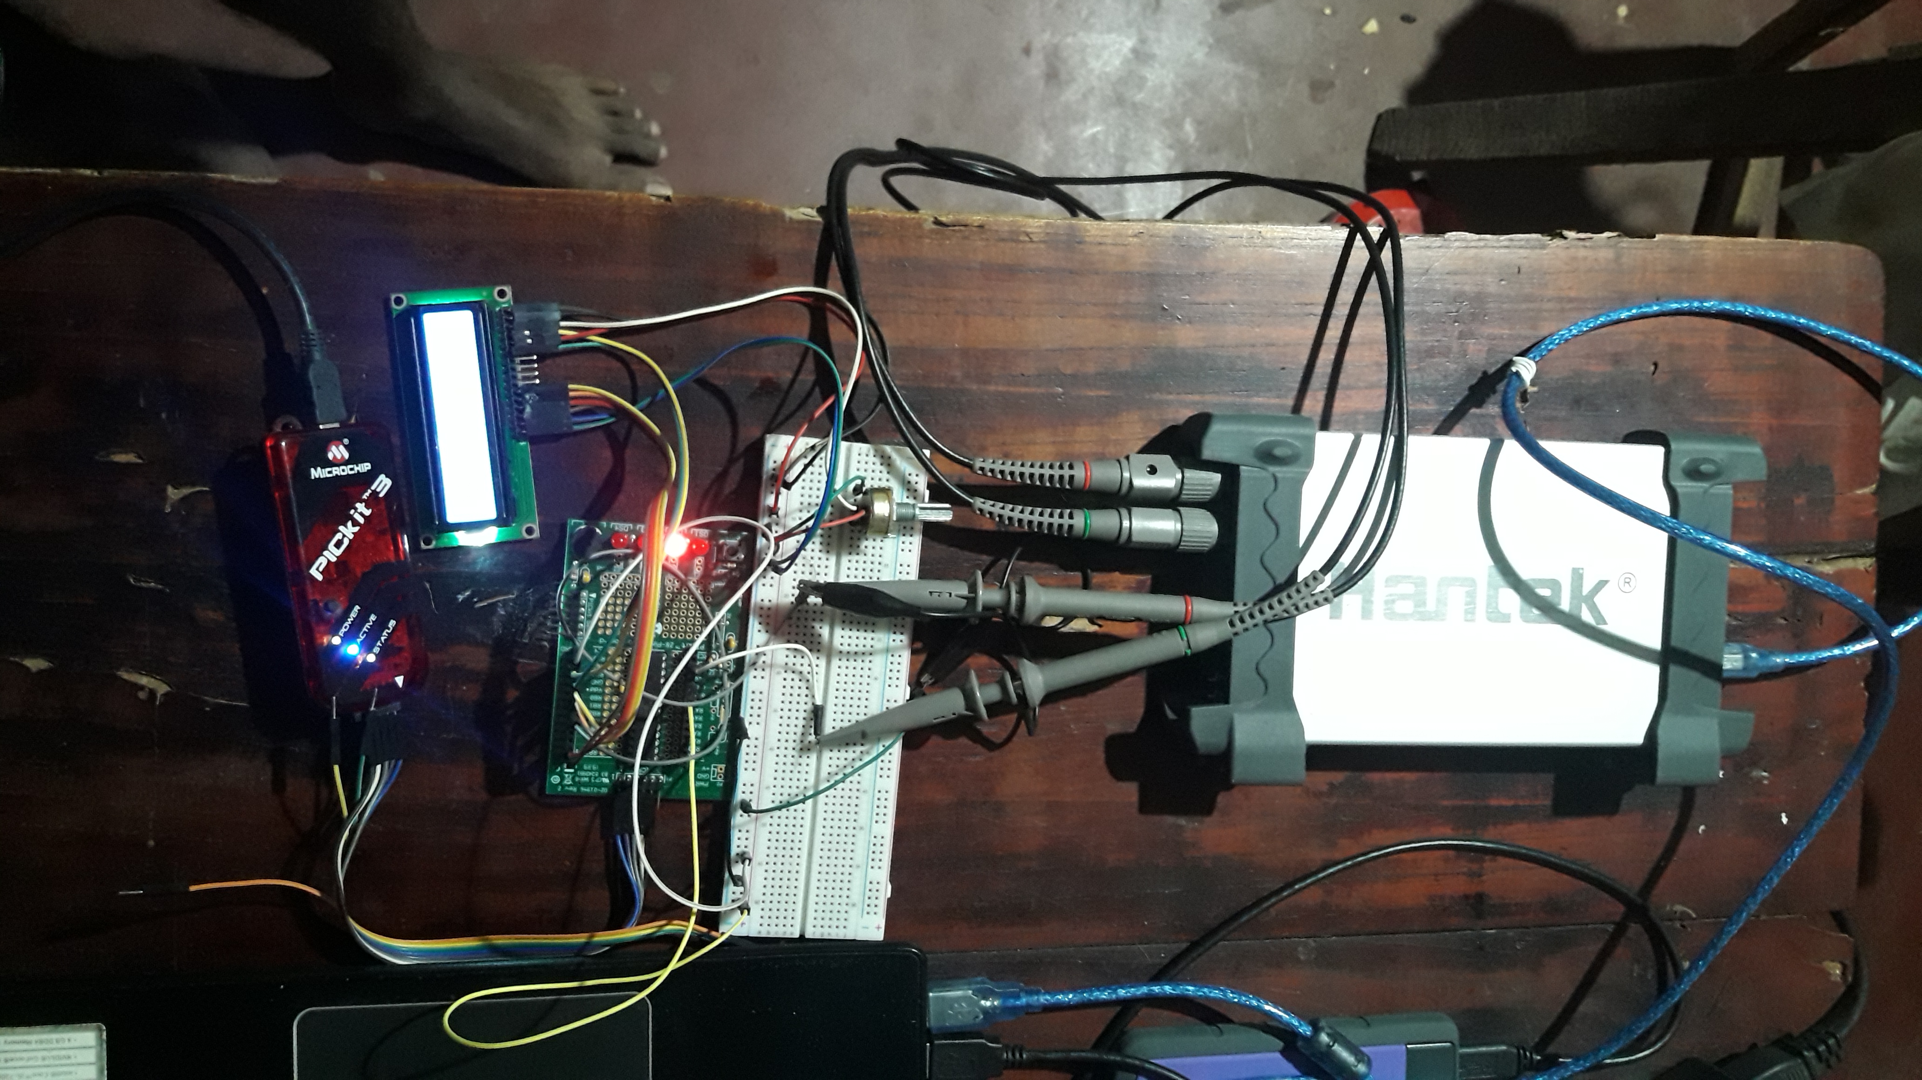
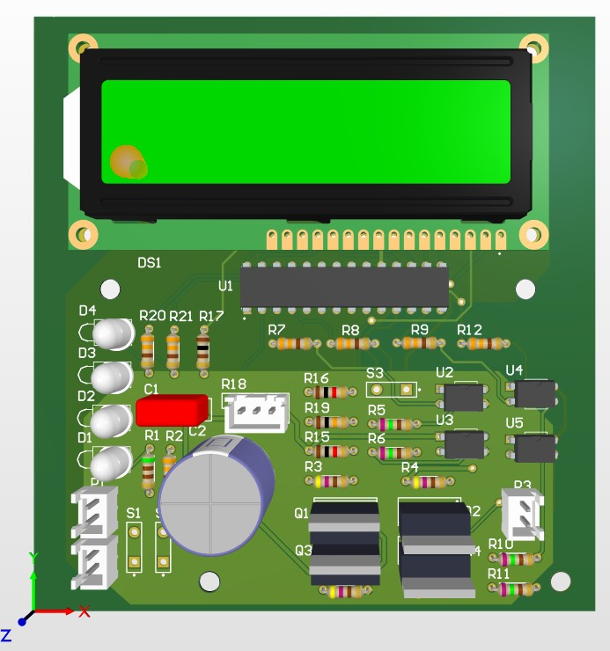
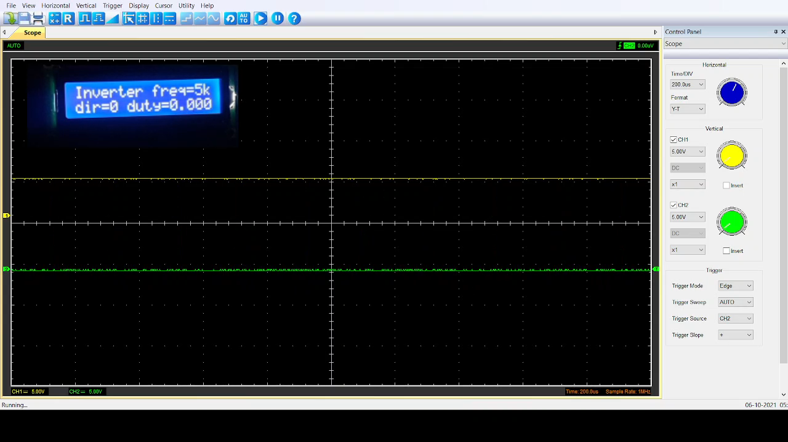
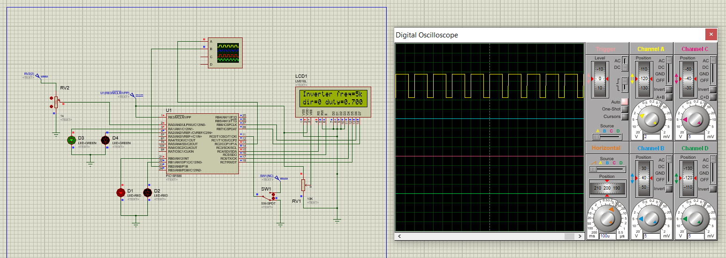
Today we do…
Program the H bridge motor driver circuit
Simulate the design
Test on a demonstration board
H bridge motor driver
Proteus simulation
Compliment PWM signal output

Slide 3
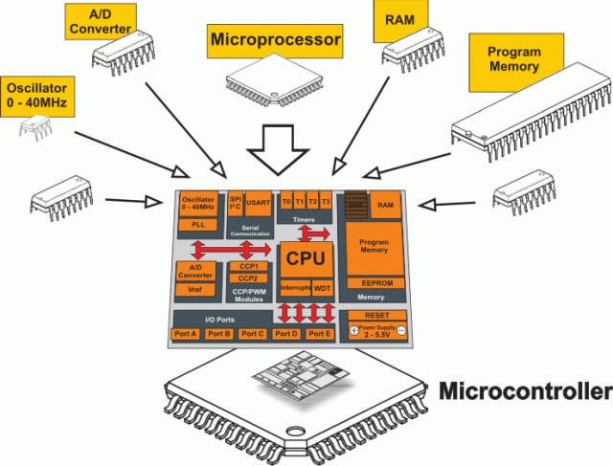
What is an MCU
A small computer on a single integrated circuit.
Processor core
Storage
RAM – data storage
ROM, EPROM, Flash – program storage
Programmable GPIOs
Communication interfaces – USART, I2C, SPI
Peripherals – timers, PWM generators, internal oscillators, ADC units

Slide 4

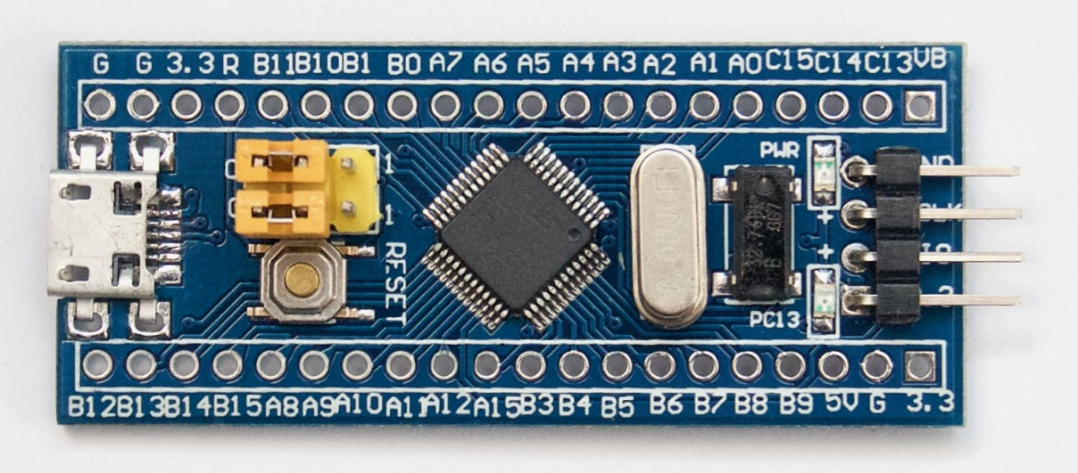
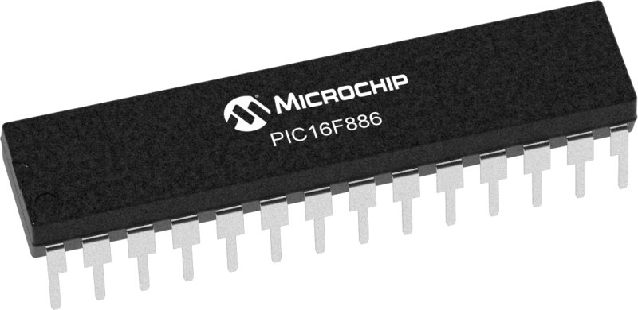
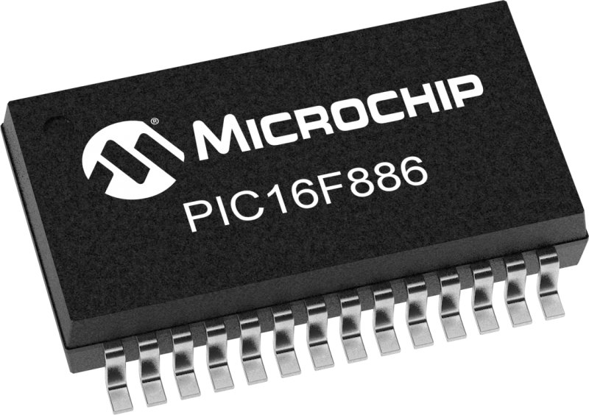
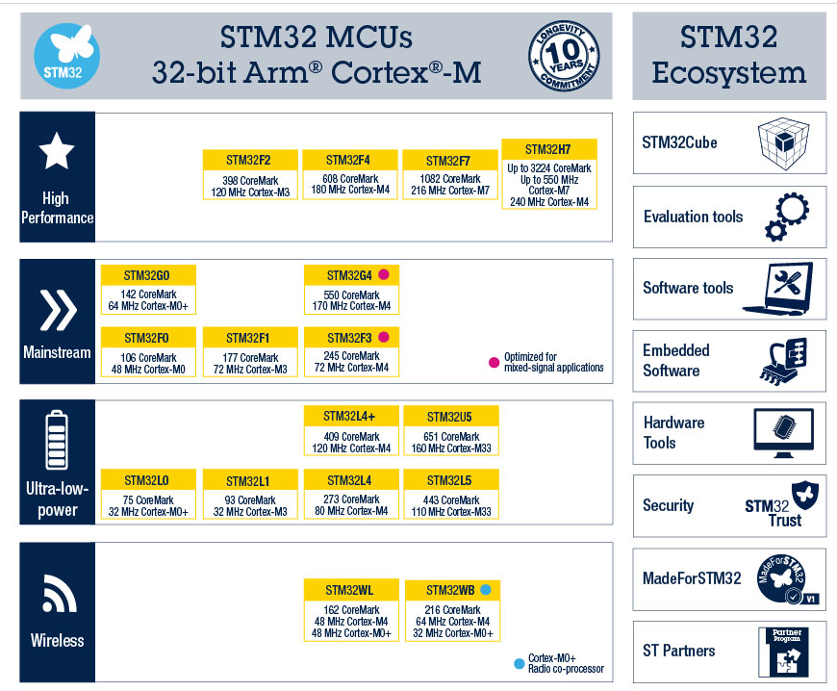
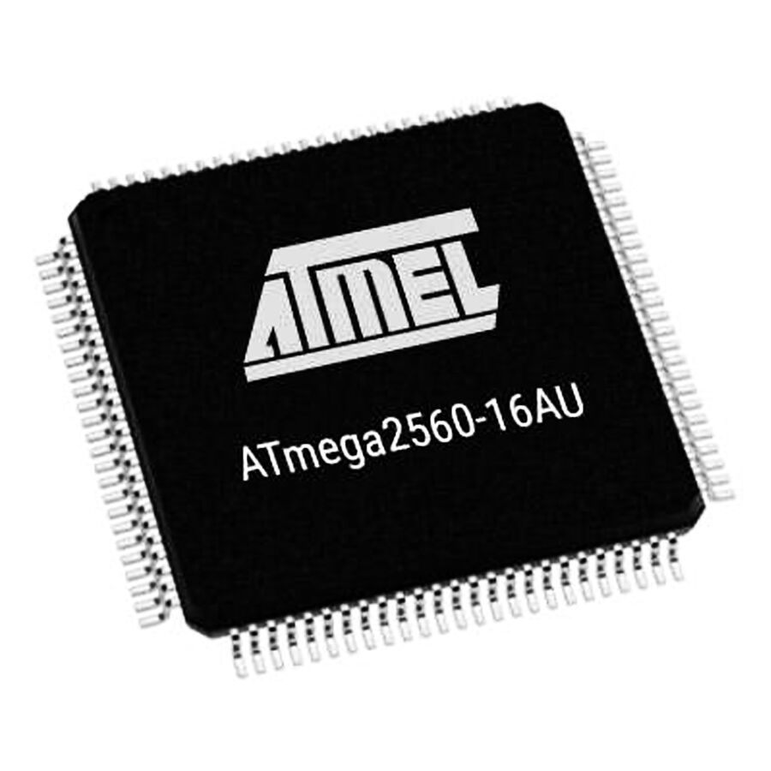
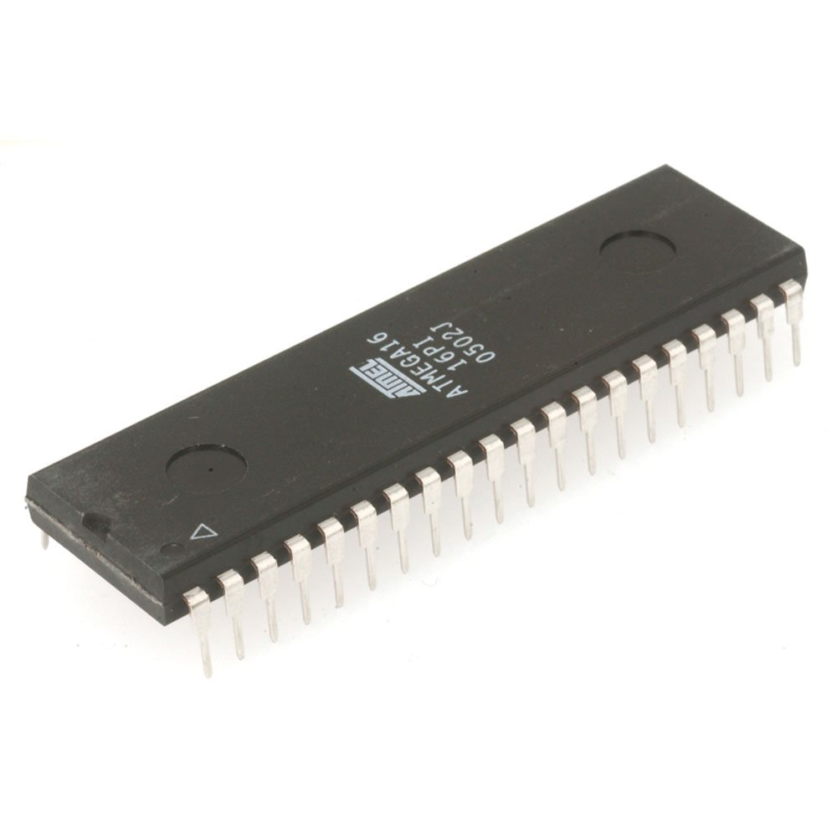
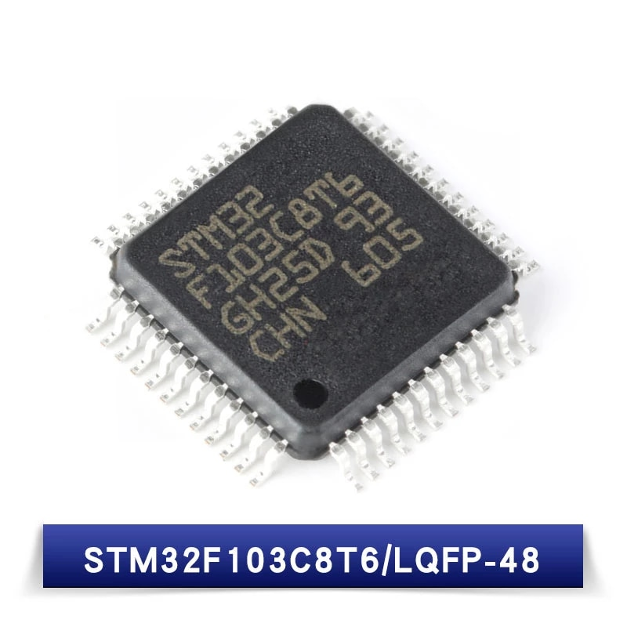
Popular microcontrollers
PIC microcontrollers
AVR microcontrollers
Arduino boards
STM32 microcontrollers
BluePill STM32
High performances
Large community
Many resources

Slide 5



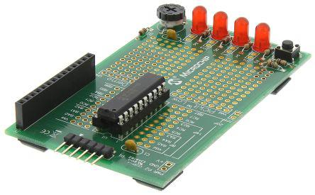
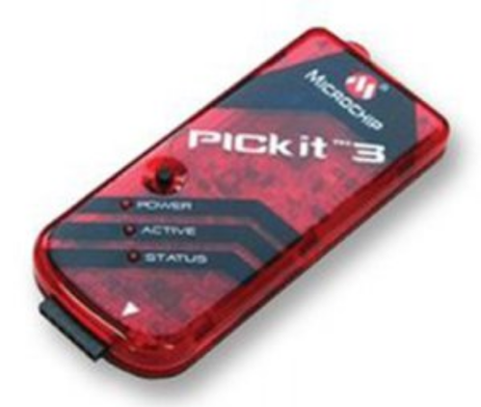
Required software & devices
MPLAB X IDE
xc8 – c compiler
Proteus Design Suit
PICkit3 programmer
PIC16f886 MCU
Design files:- https://github.com/tharinduSamare/PIC_workshop.git
PIC 28 Pin demo board

Slide 6
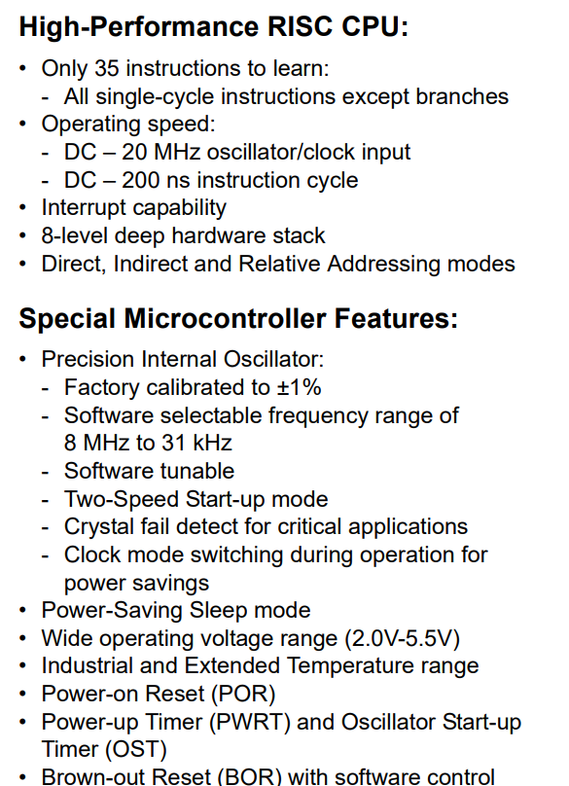
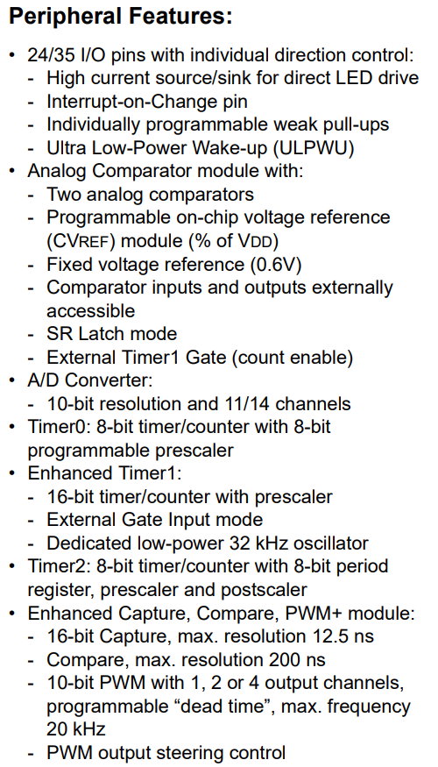
PIC16F886 datasheet
PIC16F886 datasheet

Slide 7
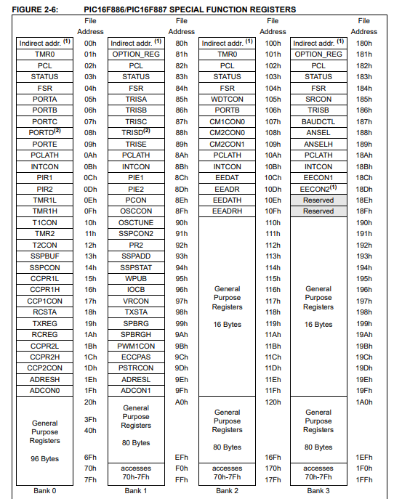
Special Function Registers
GPIOs
TRISA, TRISB … :- Decides input / output
PORTA, PORTB … :- Value of the pin (1/0)
ANSEL, ANSELH :- Pin type (Analog / digital)
PWM signals
CCP1CON – PWM type
CCPR1L – PWM duty cycle
PR2 – PWM period
T2CON – Timer_2 configurations
ADC unit
ADCON0 – ADC configurations
ANSEL, ANSELH – Pin type(analog / digital)

Slide 8
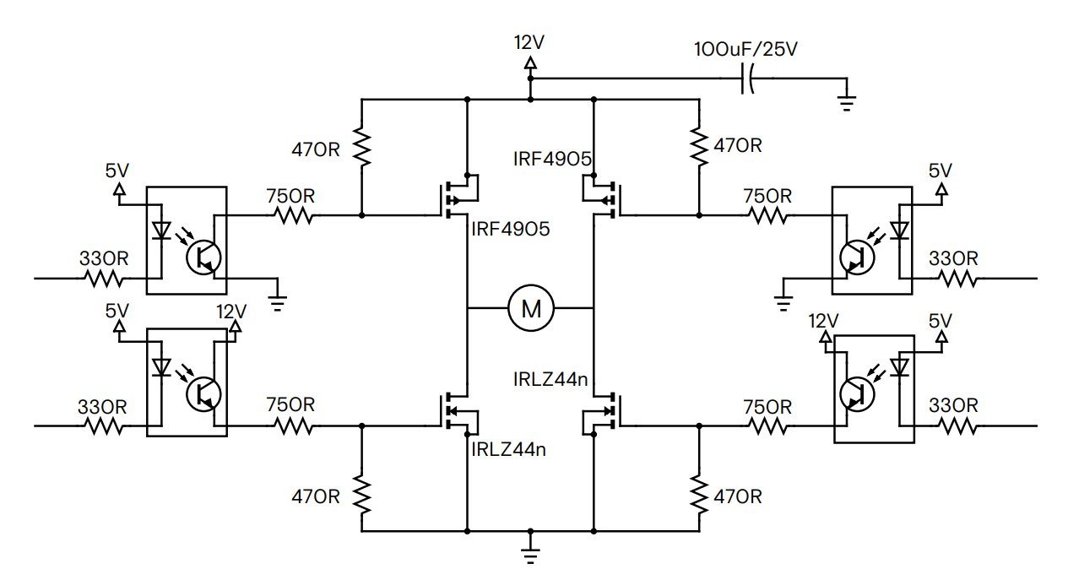
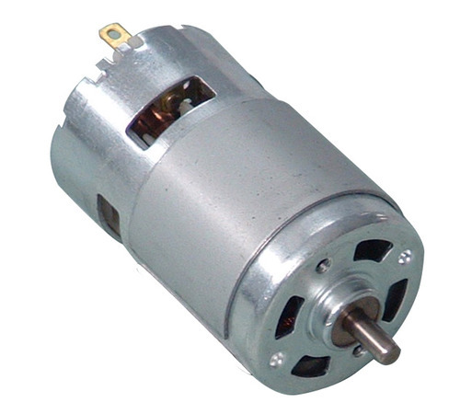
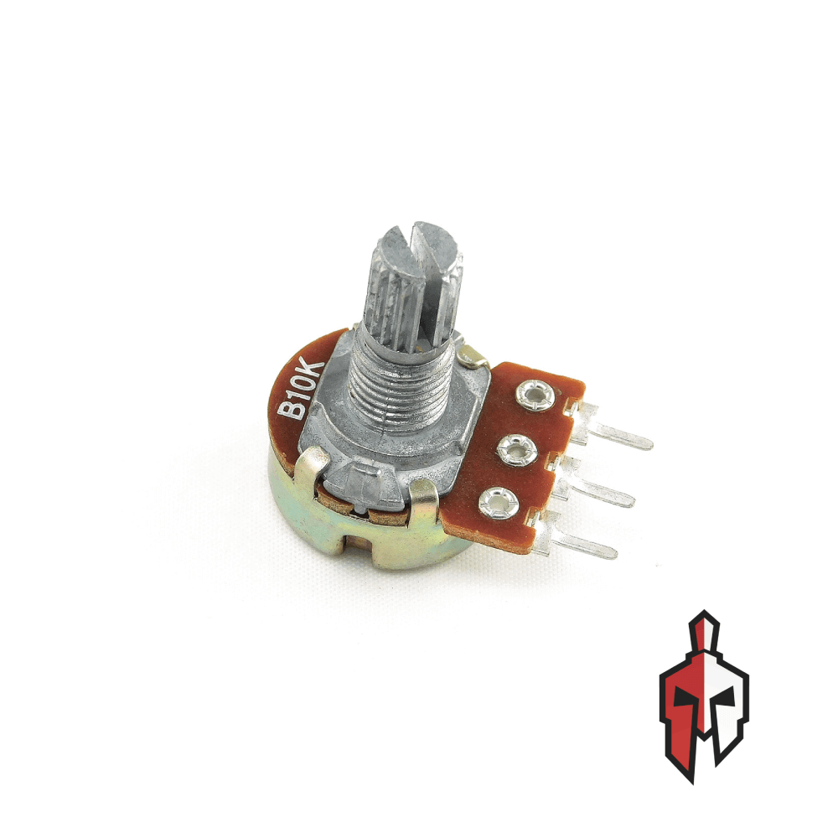
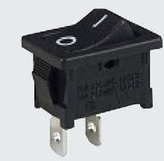
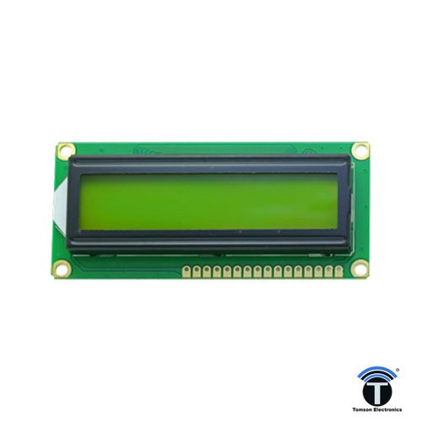
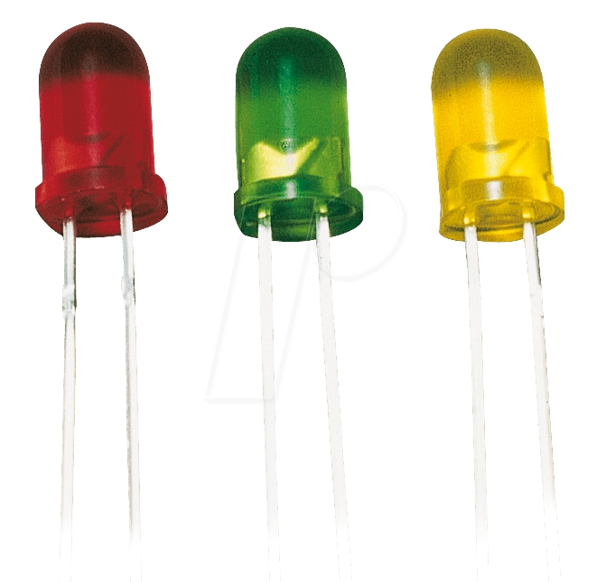
Design Block diagram
Power In (12V)
Microcontroller
Direction control
H-Bridge
Power In (5V)
To Motor
Speed control
Speed Control
Motor Direction Switch
Indication LEDs
LCD Display
H bridge motor driver

Slide 9
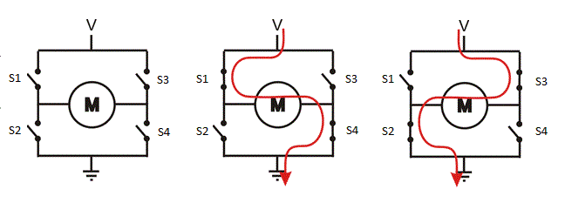
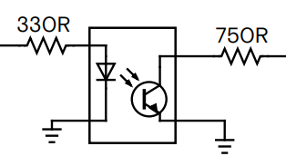
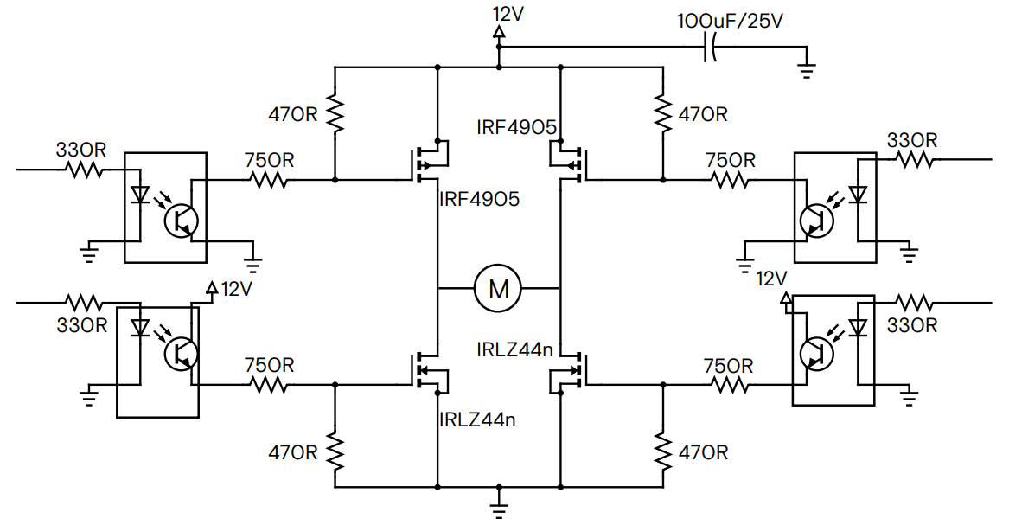
H bridge control
DC signal
DC signal
PWM signal
PWM signal

Slide 10
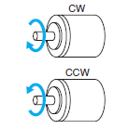
H bridge control
5V
5V
0V
0V
5V
0V

Slide 11
H bridge control
5V
5V
0V
0V
5V
0V

Slide 12
C coding
Insert Libraries
Include <stdint.h>
include “lcd.h”
#define directive
#define LED0 PORTBbits.RB0
Set or clear a register bit
PORTAbits.RA3 = 1;
PORTAbits.RA3 = 0;
RA3 = 1;
RA3 = 0;
PORTA = PORTA | (1 << 3); // 0b01000010 | 0b00001000
PORTA = PORTA & ~(1<<3); // 0b01001010 & ~(0b00001000) // 0b01001010 & 0b11110111
Set or clear a full register
PORTA = 0b10010011;
PORTA = 0x93;

Slide 13
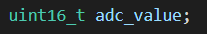
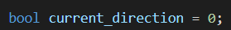
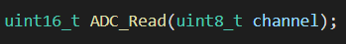
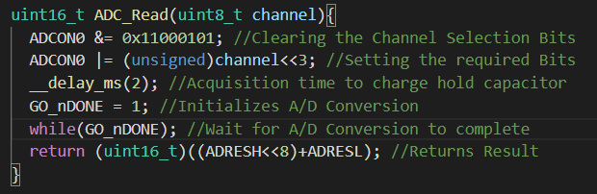
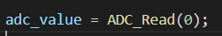
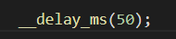
C coding
Data types
Int, float …
uint8_t, uint16_t …
bool
Functions
Function declaration
Function body
Function call
Built-in functions

Slide 14
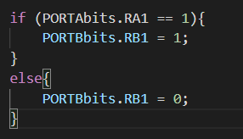
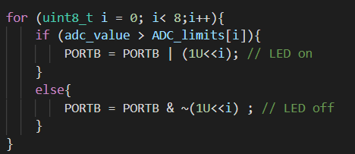
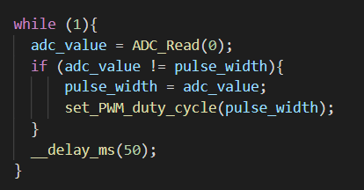
C coding
If conditions
For loops
While loops

Slide 15
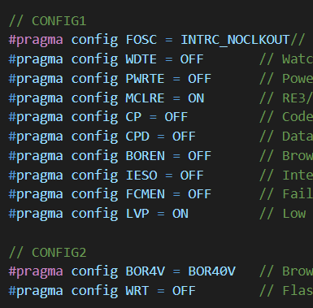
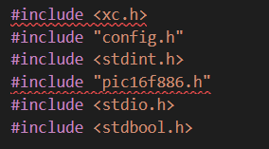
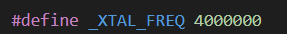
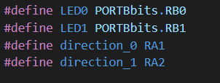
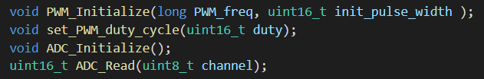
Coding
Set configuration bits
Include libraries
Set oscillator frequency
useful for delay functions
Define aliases
Define global variables
Function prototypes
Main function
Initialize the system
Infinite loop
Other functions

Slide 16
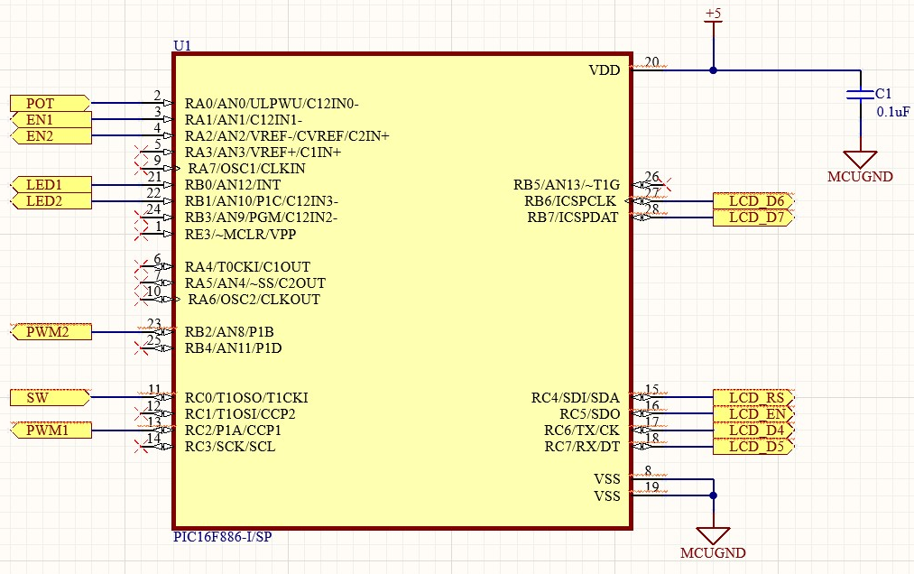
Design + simulation
Analog input signal capture
PWM signal output
LCD display
Final design - H bridge driver
Design files:- https://github.com/tharinduSamare/PIC_workshop.git
Pin connection diagram

Slide 17
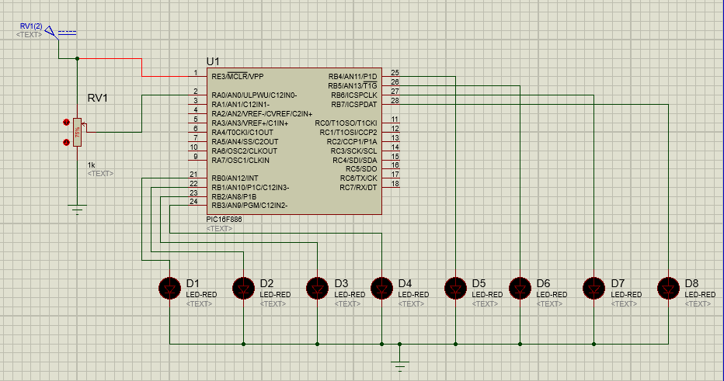
Analog input capture
GPIOs
TRISA,
PORTA, PORTB
ANSEL, ANSELH
ADC unit
ADCON0
ANSEL, ANSELH

Slide 18

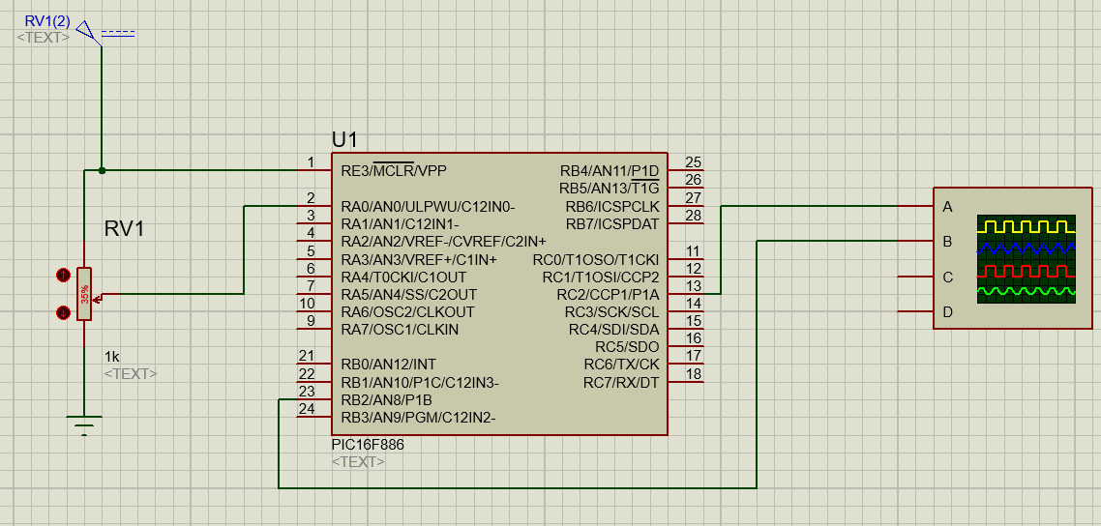
PWM signal generate
ADC unit
PR2
T2CON
CCP1CON
CCPR1L
GPIOs
TRISA, TRISB, TRISC
PORTA, PORTB, PORTC
ANSEL, ANSELH

Slide 19
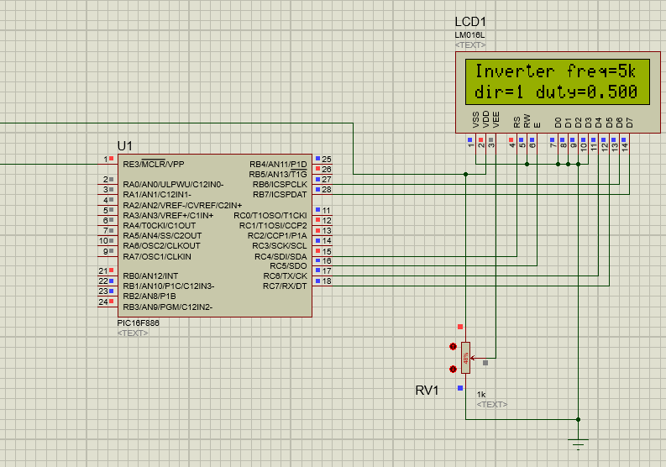
LCD display
GPIOs
TRISA, TRISB, TRISC
PORTA, PORTB, PORTC
ANSEL, ANSELH

Slide 20
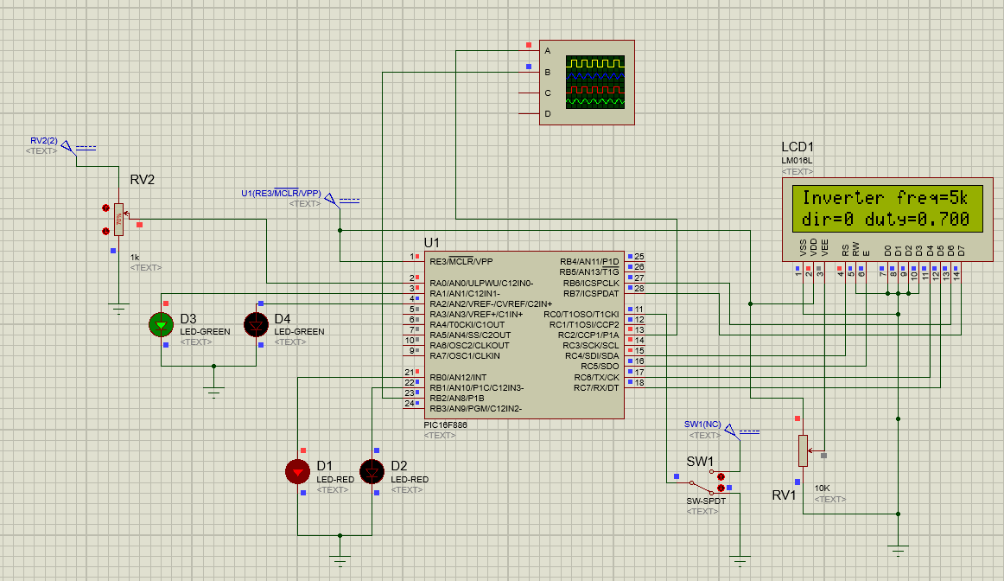
H bridge driver

Slide 21
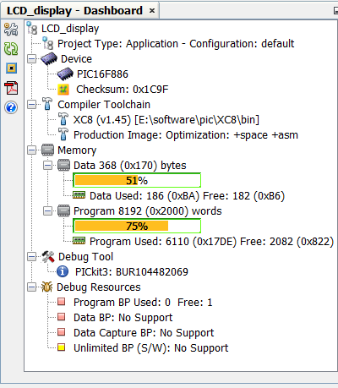
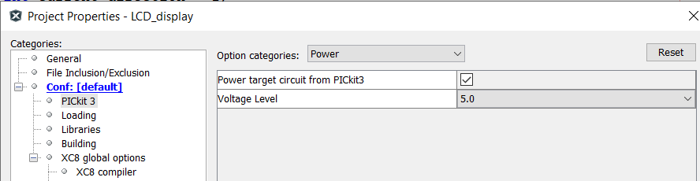
Program with PICkit3
See the memory usage
Uploading methods
Using MPLAB X IDE
Using PICkit3 software
Supply power to the MCU from PICkit

Slide 22
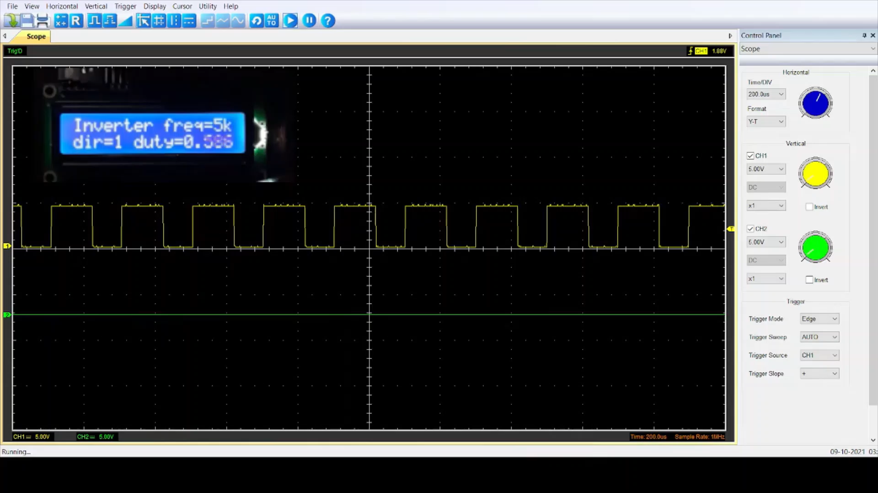
Final output
Oscilloscope output
Implementation on a demo board
Thank you!

